Slide 1
Unlocking the Potential of Machine Learning in Credit Card Fraud Detection
Machine Learning Capstone Project
Presented by
Pascal Ngo
Narayan Iyer
Pierre Diop
Oct 21, 2023

Slide 2
CONTENTS
Introduction
Data Preparation
Exploratory Data Analysis
Feature Engineering
Baseline Models
Model Tuning
Model Interpretation
Next Steps
Recommendations

Slide 3
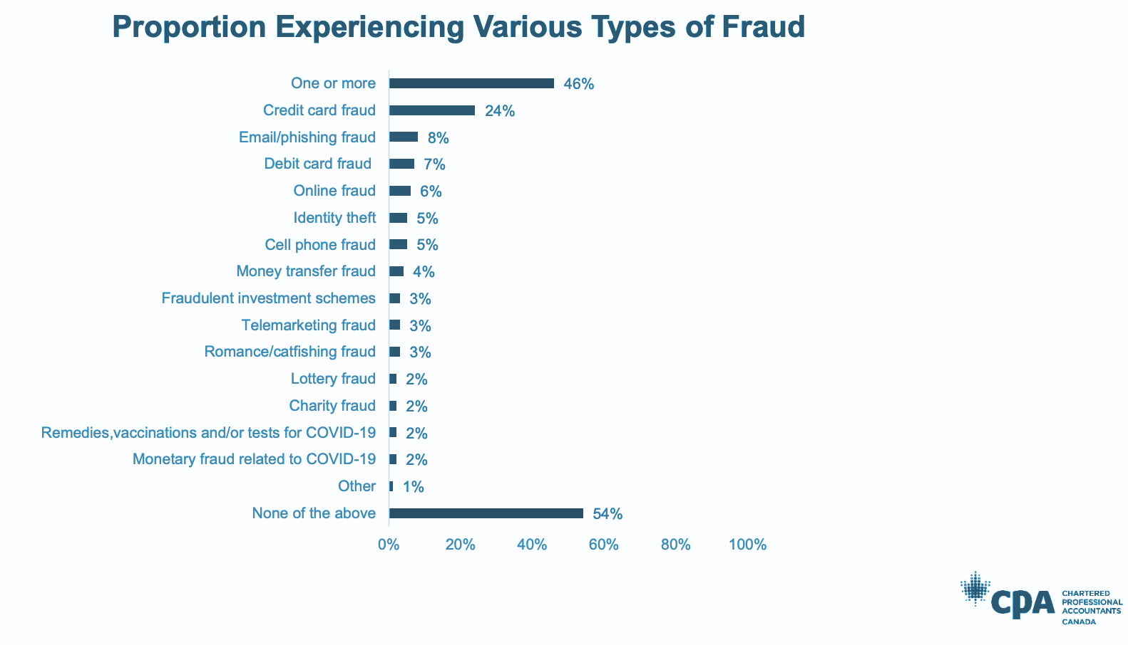
Introduction
Impact of Credit Card Fraud
Global Challenge of Credit Card Fraud:
Credit card fraud poses a substantial challenge for financial institutions, businesses, and consumers on a worldwide scale, with Canada being no stranger to this issue.
Fraud Victim Rate in Canada:
Approximately 43% of Canadians have experienced fraud or scams at some point in their lives, highlighting the pervasive nature of financial deception.
Substantial Financial Impact:
In 2021, credit card fraud resulted in financial losses of CAD 776.8 million in Canada, underscoring the need for heightened vigilance and preventive measures in the country's financial sector.

Slide 4
Machine Learning's Role in Combating Credit Card Fraud
Key Aspects
Anomaly Detection
Real-time Analysis
Pattern Recognition
Reducing False Positives
Adaptive Learning
Predictive Modeling
Cost savings
Enhanced customer experience
Final Thoughts
Machine learning is a crucial tool in the fight against credit card fraud.
Analyzes data in real-time, detects anomalies, and adapts to evolving threats.
Protects customers, reduces financial losses, and enhances security and efficiency.

Slide 5
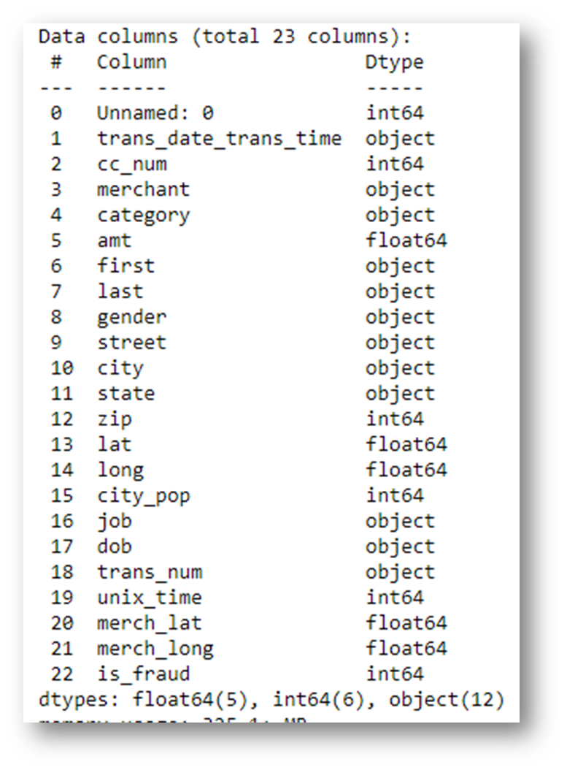
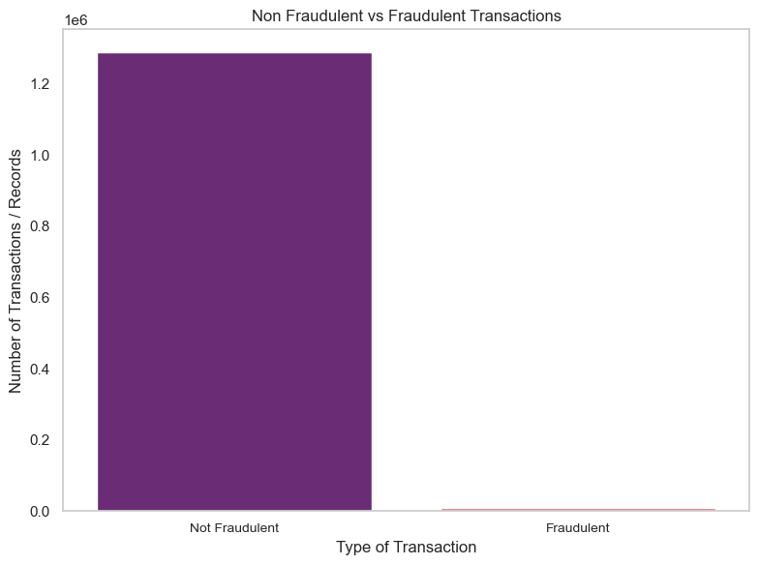
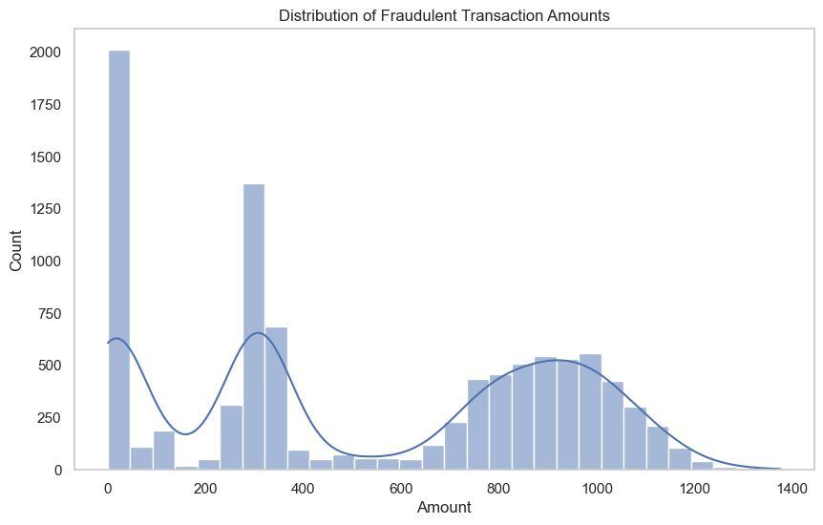
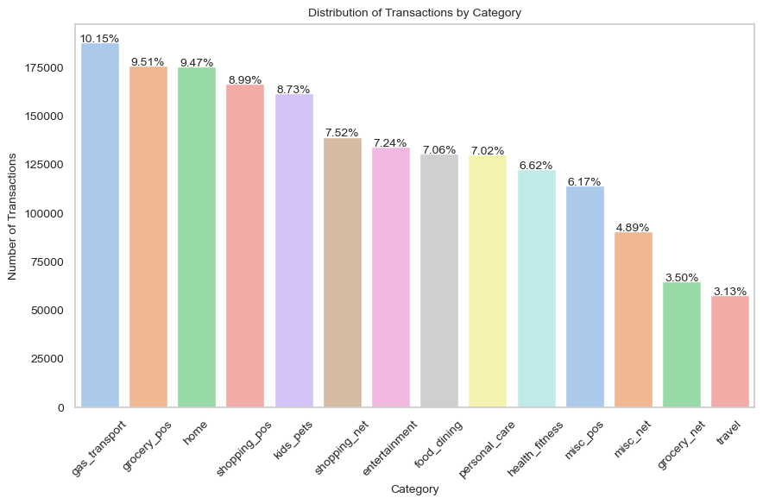
Data Preparation
Exploratory Data Analysis
Our dataset contains credit card transactions including legitimate and fraud transactions of 1000+ customers using their Credit Cards with various merchants over a period of 24 months.
The dataset consists of 1,852,394 rows and 23 columns. It is highly imbalanced as the fraudulent transactions were only 0.52% of the entire dataset i.e. 9,651 rows.
The dataset had no missing or NaN values and there were no duplicate rows.
The maximum amount in the dataset was $30,000 whereas the maximum amounts among the fraudulent transactions were up to $1,400.
The transactions were categorized in 14 categories.

Slide 6
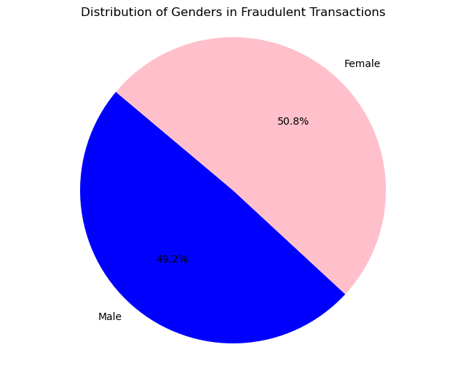
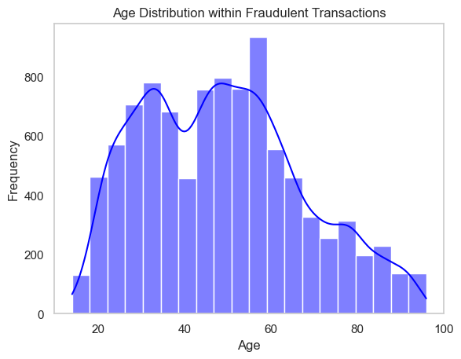
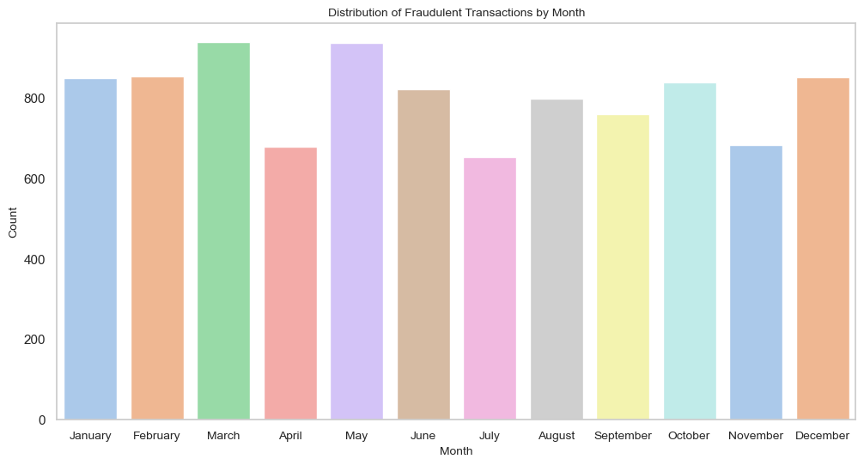
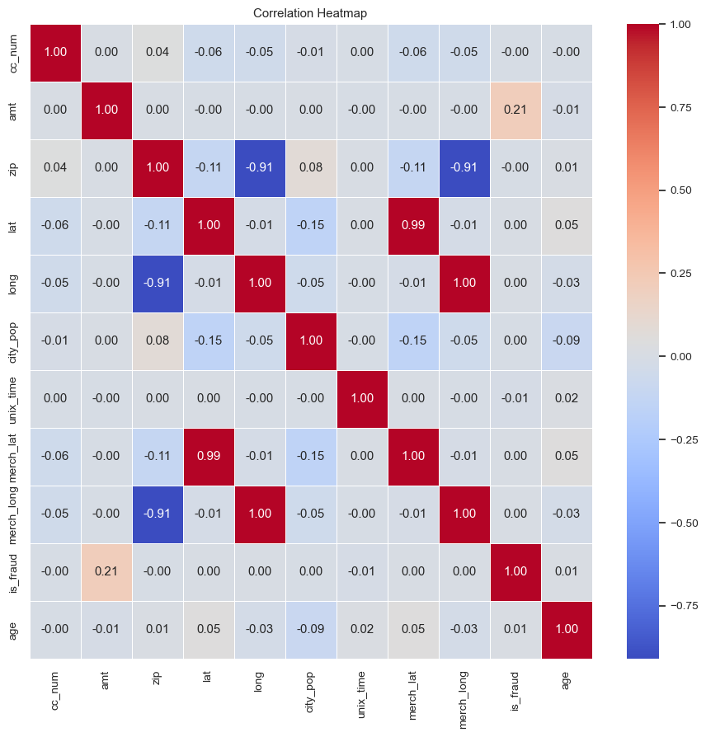
Exploratory Data Analysis
The transactions that were categorized as fraudulent had almost equal number of male & female customers.
The fraudulent transactions had a wide age group of customers ranging from 14 years old to 96 years old.
The transactions that were categorized as fraudulent were transacted across all the months of the year, all the days of the week and across all the time of the day.
The was no correlation between any numerical features in the dataset with the exception of the “amount” feature. The categorical features representing location like “zip”, “longitude”, “merch latitude” and “merch longitude” were highly correlated with each other.
The features including “Job”, “Street”, “City”, “State” and “City Population” features were categorical in nature and had a large number of uniques values.

Slide 7
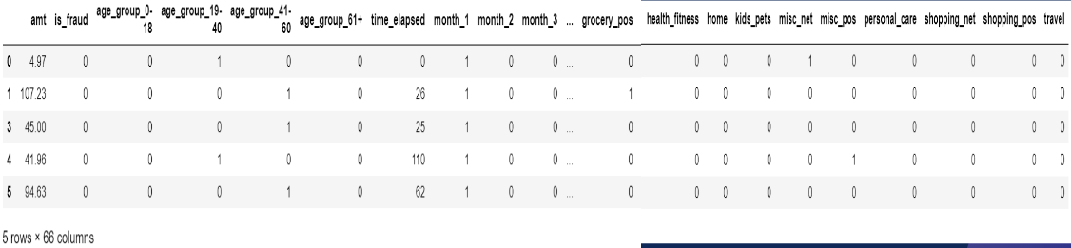
Feature Engineering
Columns dropped : Non-numerical columns, Unnamed: 0, cc_num, zip, lat, long, city_pop, unix_time, merch_lat, merch_long.
New features created : Age, Age Group, Month, Day, Hour. Time Elapsed
Feature Engineering : One-hot encoding of Gender, Age Group, Month, Day, Hour & Category
Treatment of Outliers : Dropped the Outliers from Amount Columns and dropped random values from time elapsed column.

Slide 8
Baseline Models
Algorithms | Precision | Recall | False Negatives | False Positives
Logistic Regression | 1.0 | 0.66 | 986 | 1
Decision Tree | 0.84 | 0.86 | 414 | 474
Random Forest | 1.0 | 0.83 | 508 | 6
Precision is about identifying positive cases. Recall catches as many positives as possible (fraudulent transactions), and false positives are how many false alarms are detected.
Here, we can observe that the ‘Random Forest’ algorithm has produced better results. We will try using Neural networks to compare with this model.
Due to the imbalanced dataset, we will balance the dataset using oversampling methods and proceed to an overall comparison.

Slide 9
Neural Network
Neural networks are well-suited for binary classification problems because they can capture complex patterns and make fine-grained distinctions between the two classes.
Success depends on careful data preparations, model architecture and computational resources.
Here, the score is lower compared to Random Forest with a 0.82 in Precision, 0.85 in Recall, and 376 False Positives.
Algorithms | Precision | Recall | False Negatives | False Positives
Neural Network | 0.82 | 0.85 | 337 | 1296

Slide 10
Model Tuning
We applied random sampling and adjust the scale of the 'amount' and 'time elapsed' data columns to enhance our model's performance.
The Random Forest model exhibits exceptional results with high precision (0.98) that signifies a very low rate of false alarms. While its recall (0.83) is good, there's room for improvement in capturing a higher proportion of fraudulent transactions.
Algorithms | Precision | Recall | False Negatives | False Positives
Logistic Regression | 0.05 | 0.90 | 297 | 52984
Decision Tree | 0.86 | 0.85 | 431 | 402
Random Forest | 0.98 | 0.83 | 487 | 54

Slide 11
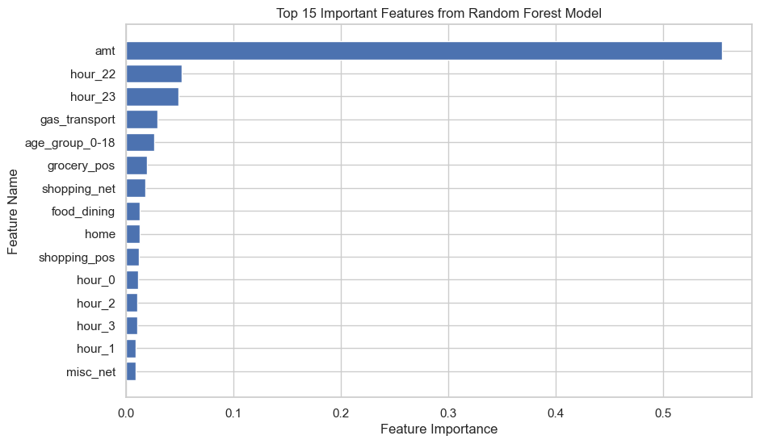
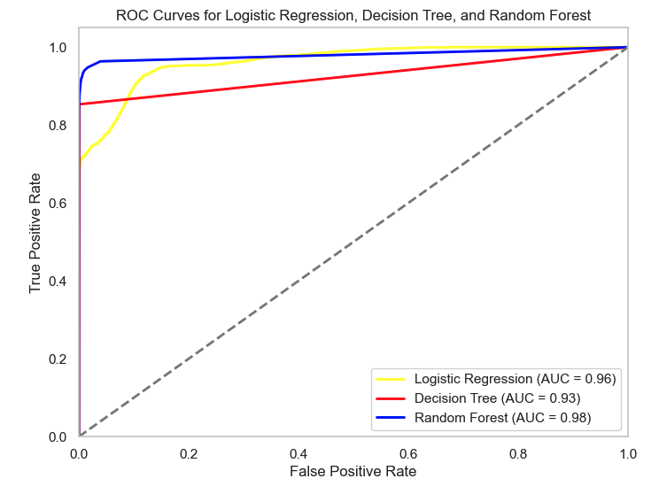
Model Interpretation
Feature Importance: The Random Forest model's feature importances were extracted to understand which features contribute the most to the model's decision-making process.
AUC-ROC Score: Provides an overall sense of a binary classifier’s performance.

Slide 12
Next Steps
Feature Experimentation
More Advanced Models
Experimenting with different feature engineering techniques using categorical features such as:
Credit card number
Location features (city, zip, state, lat, long, etc.)
Categorical features (customer and merchant details)
Adding more data to the model including most recent transactions flagged as fraudulent
Explore more advanced machine learning and artificial intelligence techniques that could further enhance detection accuracy such as:
Ensemble methods (XGBoost, Gradient Boosting, Bagging)
Long Short-Term Memory (LSTM)
Restricted Boltzmann Machines (RBM)

Slide 13
Business Recommendations
Integration of Real-time Systems
Feedback Loop
Customer Notification System
Historical Review & Analyze Trends
Begin the process of integrating the developed fraud detection tool into our real-time transaction monitoring systems.
As the tool flags transactions, set up a mechanism where our fraud review team can provide feedback on the accuracy of the flagged transactions.
Design a system to notify customers immediately if a potentially fraudulent transaction is detected.
Review historical fraudulent transactions and identify trends occurring at certain intervals such as time of day, across specific categories and locations.

Slide 14
Thank You For Listening
Questions ?

